Slide 1
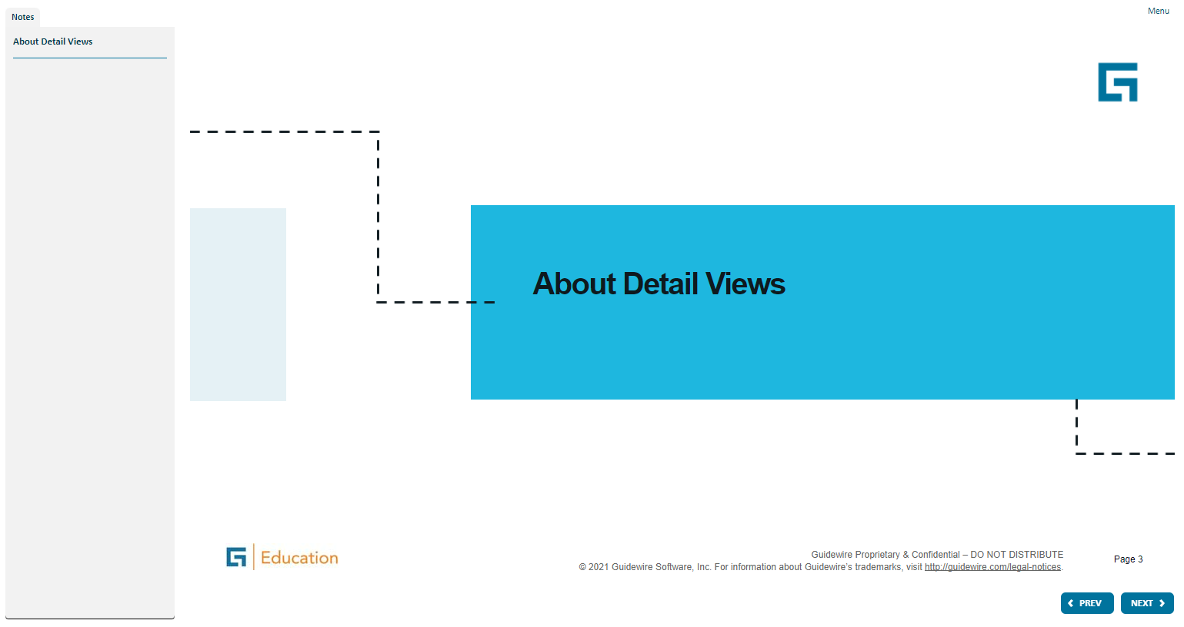
Notes:
Container widgets hold other widgets. Each one can be defined either in its own file or as a child container within some other PCF element file.
Both Widget and Location are conceptual representations in this diagram. There are no <Widget /> or <Location /> elements. Similarly, both Atomic Widget and Container Widget are conceptual representations. There are no <Atomic Widget /> or <Container Widget /> elements.
The PCF object model is container-based. Each screen element is modeled as an object, which may contain other objects. The hierarchical structure simplifies the task of locating and modifying visual elements. Furthermore, each element can be declared as an independent and therefore reusable element.

Slide 2
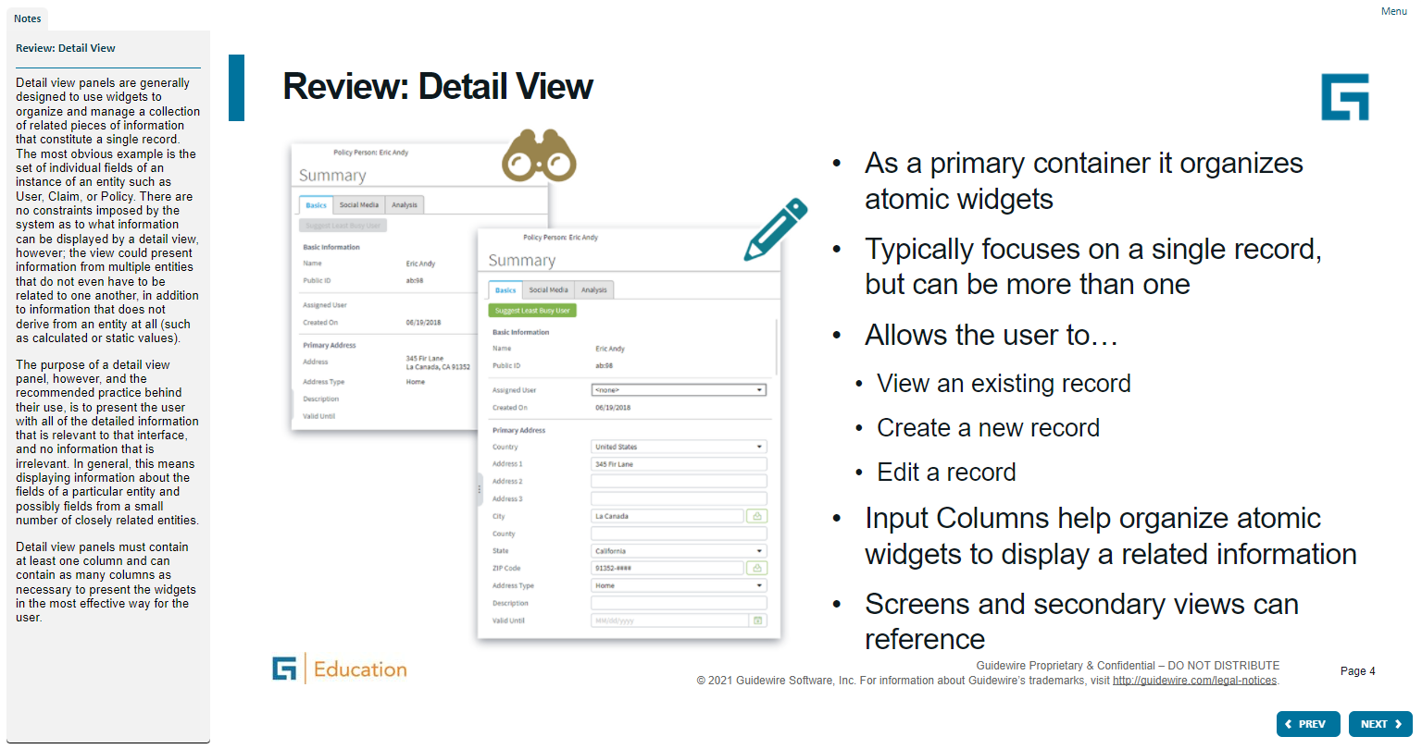
Notes:
Container widgets hold other widgets. Each one can be defined either in its own file or as a child container within some other PCF element file.
Both Widget and Location are conceptual representations in this diagram. There are no <Widget /> or <Location /> elements. Similarly, both Atomic Widget and Container Widget are conceptual representations. There are no <Atomic Widget /> or <Container Widget /> elements.
The PCF object model is container-based. Each screen element is modeled as an object, which may contain other objects. The hierarchical structure simplifies the task of locating and modifying visual elements. Furthermore, each element can be declared as an independent and therefore reusable element.

Slide 3
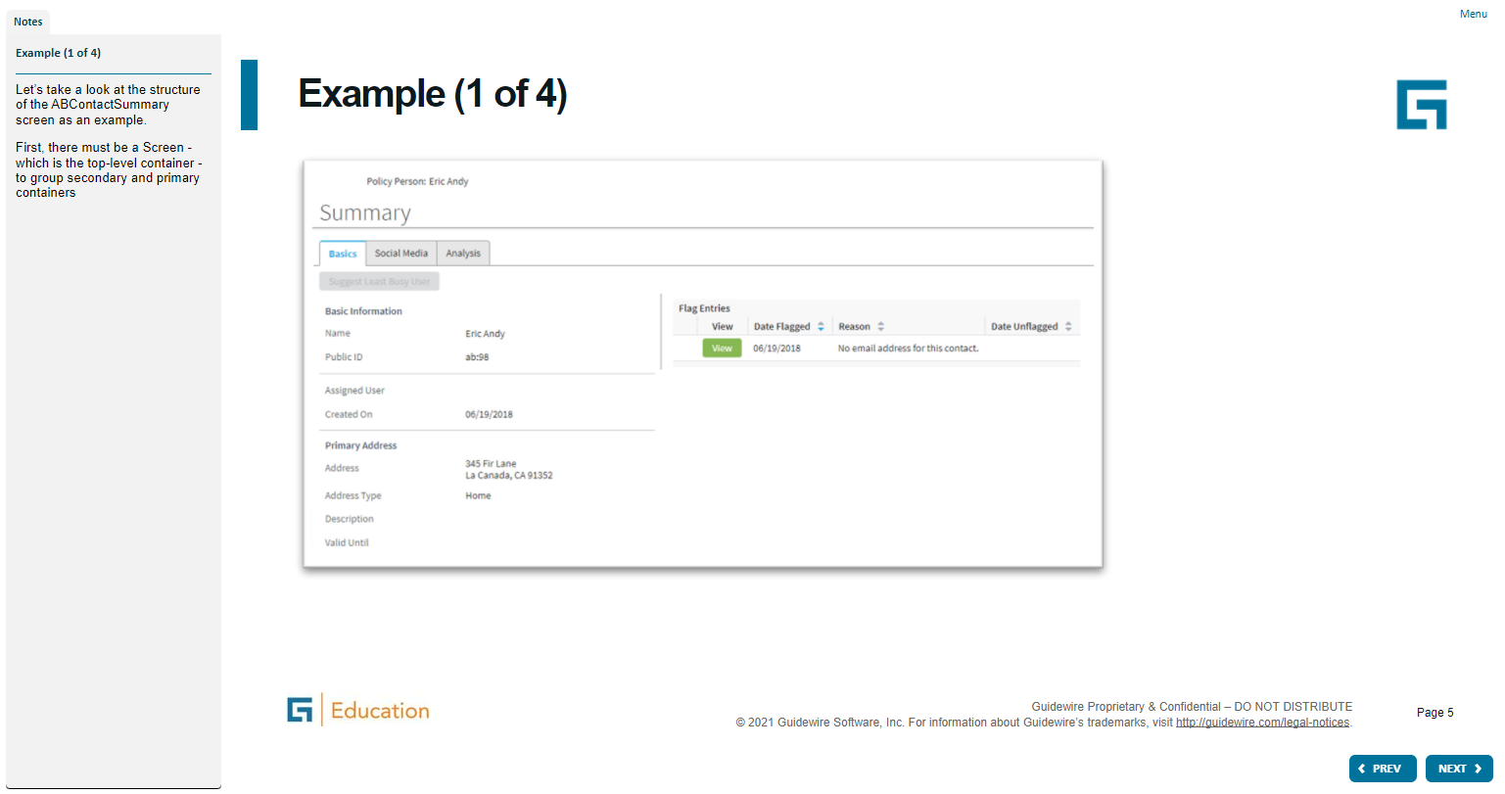
Notes:
Container widgets hold other widgets. Each one can be defined either in its own file or as a child container within some other PCF element file.
Both Widget and Location are conceptual representations in this diagram. There are no <Widget /> or <Location /> elements. Similarly, both Atomic Widget and Container Widget are conceptual representations. There are no <Atomic Widget /> or <Container Widget /> elements.
The PCF object model is container-based. Each screen element is modeled as an object, which may contain other objects. The hierarchical structure simplifies the task of locating and modifying visual elements. Furthermore, each element can be declared as an independent and therefore reusable element.

Slide 4
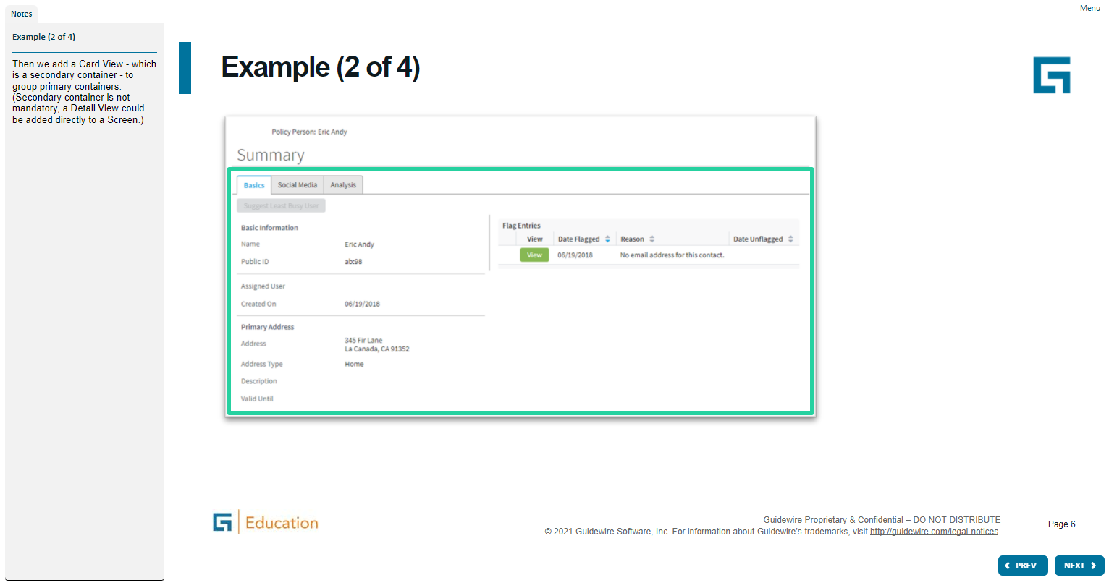
Notes:
Container widgets hold other widgets. Each one can be defined either in its own file or as a child container within some other PCF element file.
Both Widget and Location are conceptual representations in this diagram. There are no <Widget /> or <Location /> elements. Similarly, both Atomic Widget and Container Widget are conceptual representations. There are no <Atomic Widget /> or <Container Widget /> elements.
The PCF object model is container-based. Each screen element is modeled as an object, which may contain other objects. The hierarchical structure simplifies the task of locating and modifying visual elements. Furthermore, each element can be declared as an independent and therefore reusable element.

Slide 5
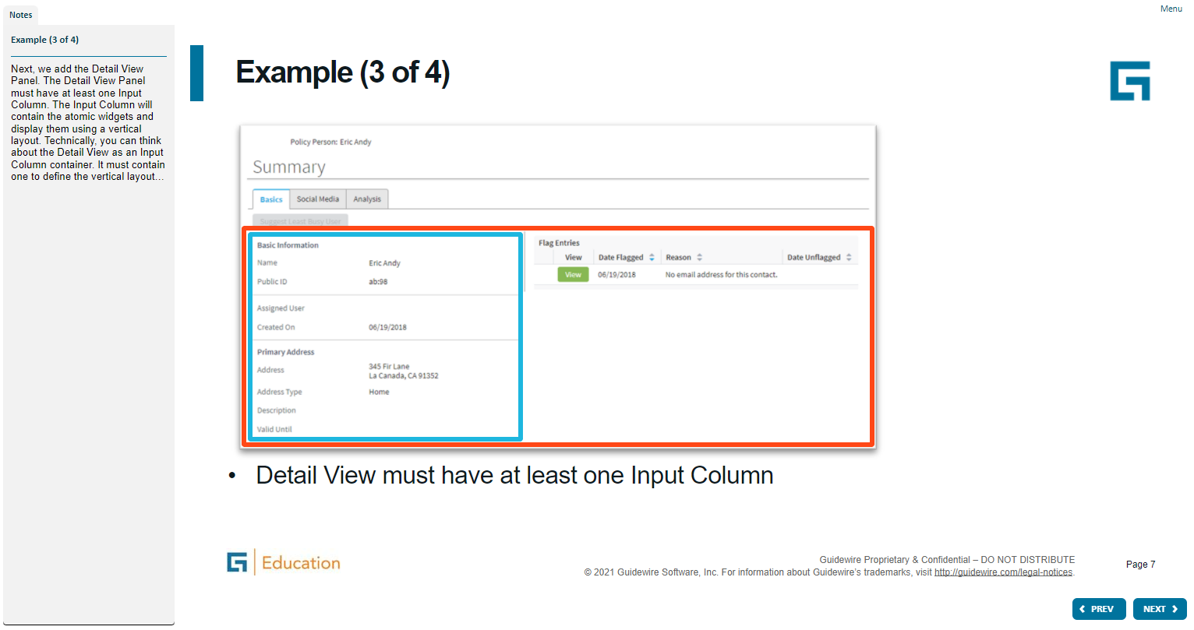
Notes:
Container widgets hold other widgets. Each one can be defined either in its own file or as a child container within some other PCF element file.
Both Widget and Location are conceptual representations in this diagram. There are no <Widget /> or <Location /> elements. Similarly, both Atomic Widget and Container Widget are conceptual representations. There are no <Atomic Widget /> or <Container Widget /> elements.
The PCF object model is container-based. Each screen element is modeled as an object, which may contain other objects. The hierarchical structure simplifies the task of locating and modifying visual elements. Furthermore, each element can be declared as an independent and therefore reusable element.

Slide 6
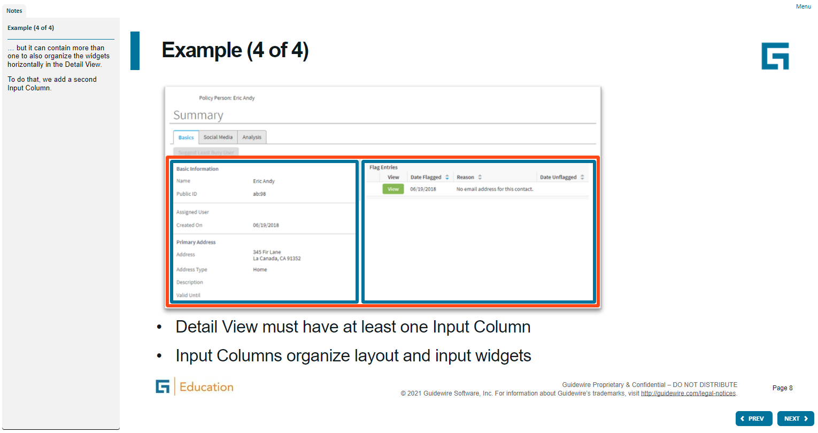
Notes:
Container widgets hold other widgets. Each one can be defined either in its own file or as a child container within some other PCF element file.
Both Widget and Location are conceptual representations in this diagram. There are no <Widget /> or <Location /> elements. Similarly, both Atomic Widget and Container Widget are conceptual representations. There are no <Atomic Widget /> or <Container Widget /> elements.
The PCF object model is container-based. Each screen element is modeled as an object, which may contain other objects. The hierarchical structure simplifies the task of locating and modifying visual elements. Furthermore, each element can be declared as an independent and therefore reusable element.

Slide 7
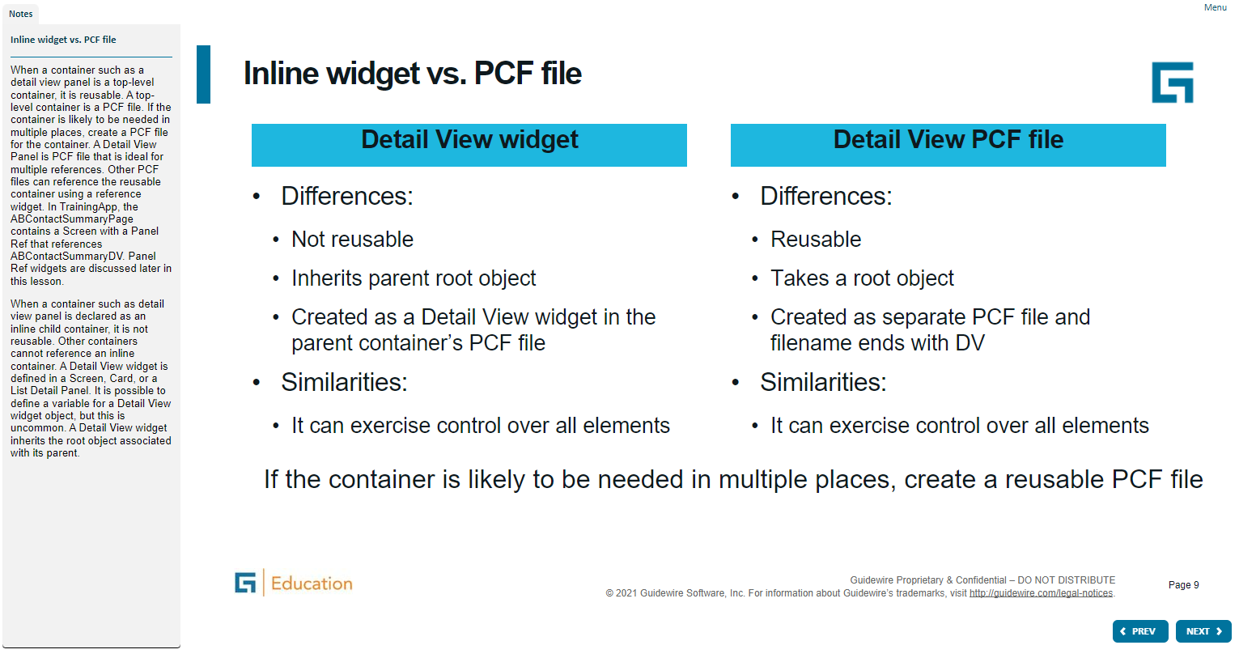
Notes:
Container widgets hold other widgets. Each one can be defined either in its own file or as a child container within some other PCF element file.
Both Widget and Location are conceptual representations in this diagram. There are no <Widget /> or <Location /> elements. Similarly, both Atomic Widget and Container Widget are conceptual representations. There are no <Atomic Widget /> or <Container Widget /> elements.
The PCF object model is container-based. Each screen element is modeled as an object, which may contain other objects. The hierarchical structure simplifies the task of locating and modifying visual elements. Furthermore, each element can be declared as an independent and therefore reusable element.

Slide 8
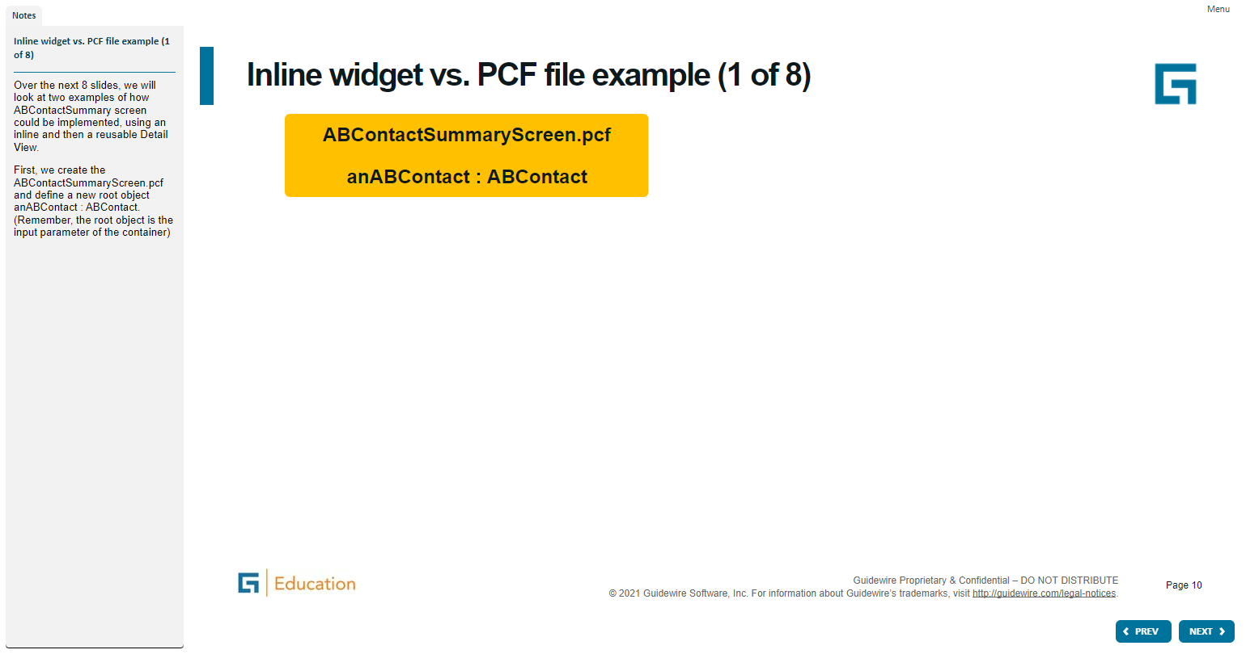
Notes:
Container widgets hold other widgets. Each one can be defined either in its own file or as a child container within some other PCF element file.
Both Widget and Location are conceptual representations in this diagram. There are no <Widget /> or <Location /> elements. Similarly, both Atomic Widget and Container Widget are conceptual representations. There are no <Atomic Widget /> or <Container Widget /> elements.
The PCF object model is container-based. Each screen element is modeled as an object, which may contain other objects. The hierarchical structure simplifies the task of locating and modifying visual elements. Furthermore, each element can be declared as an independent and therefore reusable element.

Slide 9
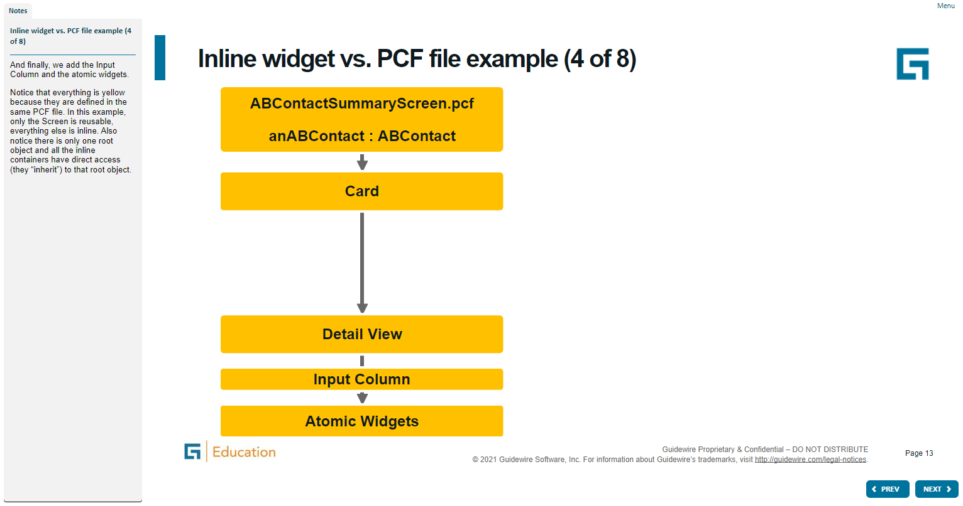
Notes:
Container widgets hold other widgets. Each one can be defined either in its own file or as a child container within some other PCF element file.
Both Widget and Location are conceptual representations in this diagram. There are no <Widget /> or <Location /> elements. Similarly, both Atomic Widget and Container Widget are conceptual representations. There are no <Atomic Widget /> or <Container Widget /> elements.
The PCF object model is container-based. Each screen element is modeled as an object, which may contain other objects. The hierarchical structure simplifies the task of locating and modifying visual elements. Furthermore, each element can be declared as an independent and therefore reusable element.

Slide 10
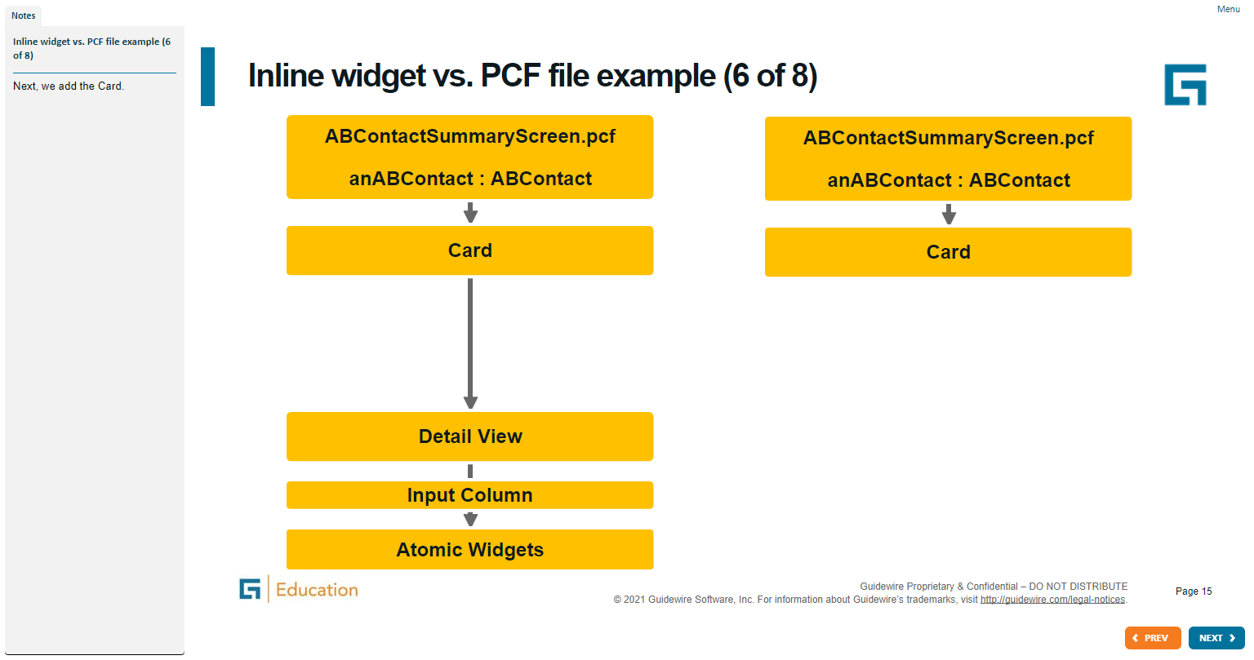
Notes:
Container widgets hold other widgets. Each one can be defined either in its own file or as a child container within some other PCF element file.
Both Widget and Location are conceptual representations in this diagram. There are no <Widget /> or <Location /> elements. Similarly, both Atomic Widget and Container Widget are conceptual representations. There are no <Atomic Widget /> or <Container Widget /> elements.
The PCF object model is container-based. Each screen element is modeled as an object, which may contain other objects. The hierarchical structure simplifies the task of locating and modifying visual elements. Furthermore, each element can be declared as an independent and therefore reusable element.

Slide 11
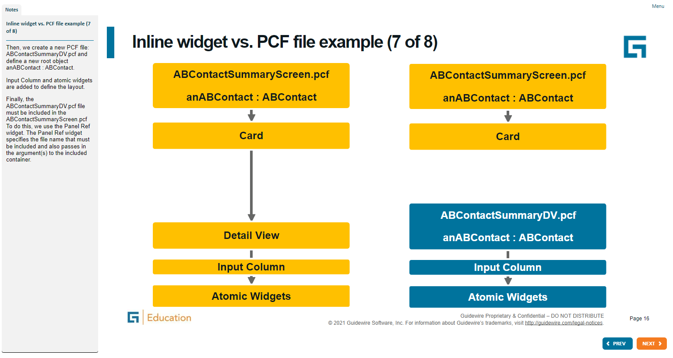
Notes:
Container widgets hold other widgets. Each one can be defined either in its own file or as a child container within some other PCF element file.
Both Widget and Location are conceptual representations in this diagram. There are no <Widget /> or <Location /> elements. Similarly, both Atomic Widget and Container Widget are conceptual representations. There are no <Atomic Widget /> or <Container Widget /> elements.
The PCF object model is container-based. Each screen element is modeled as an object, which may contain other objects. The hierarchical structure simplifies the task of locating and modifying visual elements. Furthermore, each element can be declared as an independent and therefore reusable element.

Slide 12
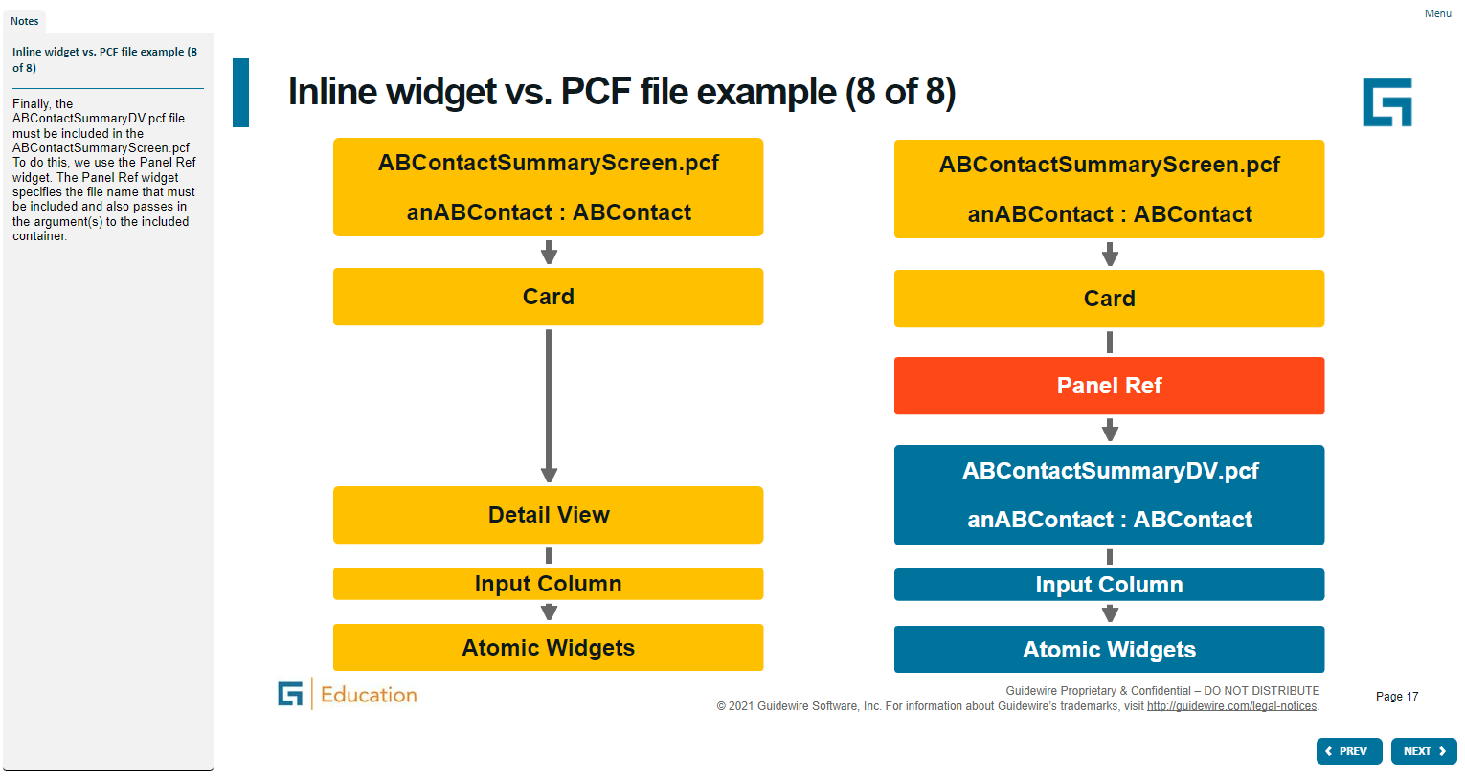
Notes:
Container widgets hold other widgets. Each one can be defined either in its own file or as a child container within some other PCF element file.
Both Widget and Location are conceptual representations in this diagram. There are no <Widget /> or <Location /> elements. Similarly, both Atomic Widget and Container Widget are conceptual representations. There are no <Atomic Widget /> or <Container Widget /> elements.
The PCF object model is container-based. Each screen element is modeled as an object, which may contain other objects. The hierarchical structure simplifies the task of locating and modifying visual elements. Furthermore, each element can be declared as an independent and therefore reusable element.

Slide 13
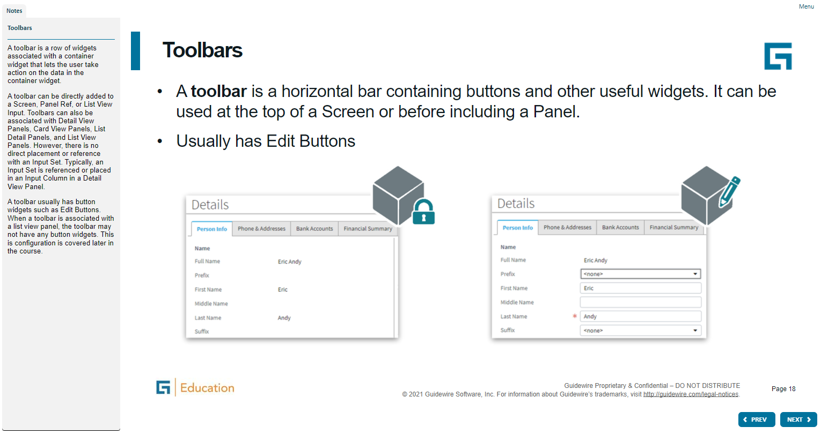
Notes:
Container widgets hold other widgets. Each one can be defined either in its own file or as a child container within some other PCF element file.
Both Widget and Location are conceptual representations in this diagram. There are no <Widget /> or <Location /> elements. Similarly, both Atomic Widget and Container Widget are conceptual representations. There are no <Atomic Widget /> or <Container Widget /> elements.
The PCF object model is container-based. Each screen element is modeled as an object, which may contain other objects. The hierarchical structure simplifies the task of locating and modifying visual elements. Furthermore, each element can be declared as an independent and therefore reusable element.

Slide 14
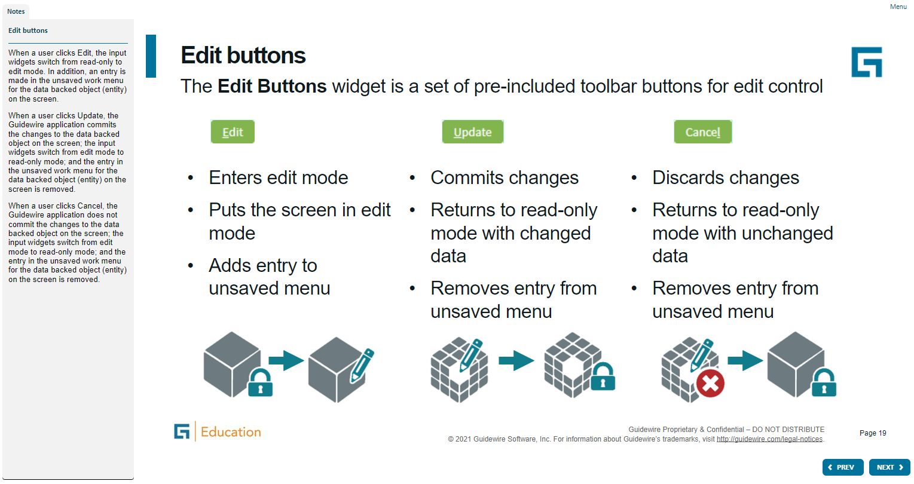
Notes:
Container widgets hold other widgets. Each one can be defined either in its own file or as a child container within some other PCF element file.
Both Widget and Location are conceptual representations in this diagram. There are no <Widget /> or <Location /> elements. Similarly, both Atomic Widget and Container Widget are conceptual representations. There are no <Atomic Widget /> or <Container Widget /> elements.
The PCF object model is container-based. Each screen element is modeled as an object, which may contain other objects. The hierarchical structure simplifies the task of locating and modifying visual elements. Furthermore, each element can be declared as an independent and therefore reusable element.

Slide 15
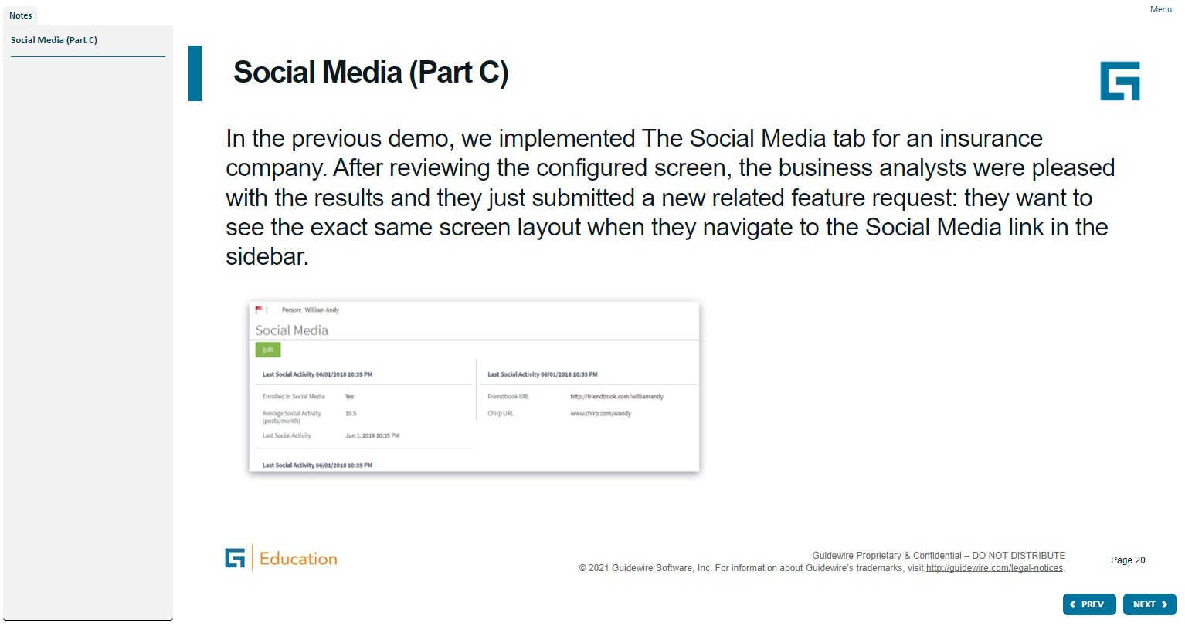
Notes:
Container widgets hold other widgets. Each one can be defined either in its own file or as a child container within some other PCF element file.
Both Widget and Location are conceptual representations in this diagram. There are no <Widget /> or <Location /> elements. Similarly, both Atomic Widget and Container Widget are conceptual representations. There are no <Atomic Widget /> or <Container Widget /> elements.
The PCF object model is container-based. Each screen element is modeled as an object, which may contain other objects. The hierarchical structure simplifies the task of locating and modifying visual elements. Furthermore, each element can be declared as an independent and therefore reusable element.

Slide 16
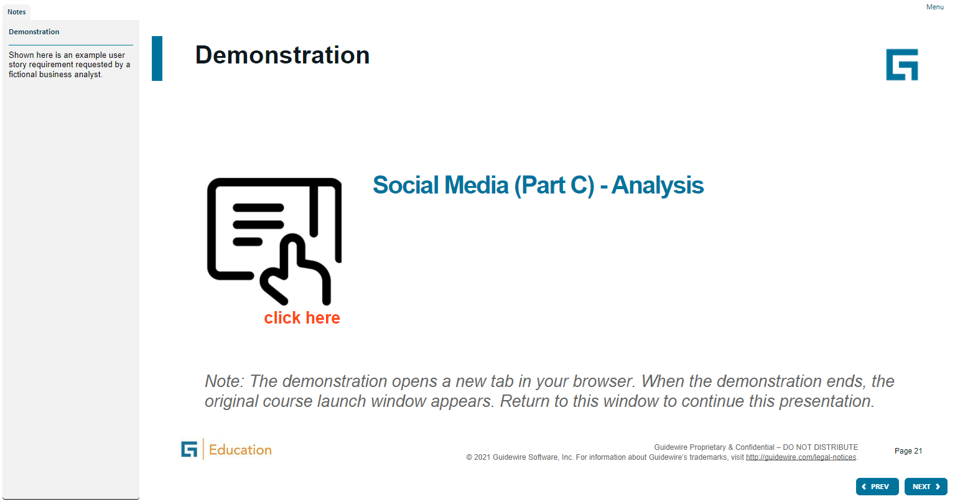
Notes:
Container widgets hold other widgets. Each one can be defined either in its own file or as a child container within some other PCF element file.
Both Widget and Location are conceptual representations in this diagram. There are no <Widget /> or <Location /> elements. Similarly, both Atomic Widget and Container Widget are conceptual representations. There are no <Atomic Widget /> or <Container Widget /> elements.
The PCF object model is container-based. Each screen element is modeled as an object, which may contain other objects. The hierarchical structure simplifies the task of locating and modifying visual elements. Furthermore, each element can be declared as an independent and therefore reusable element.

Slide 17
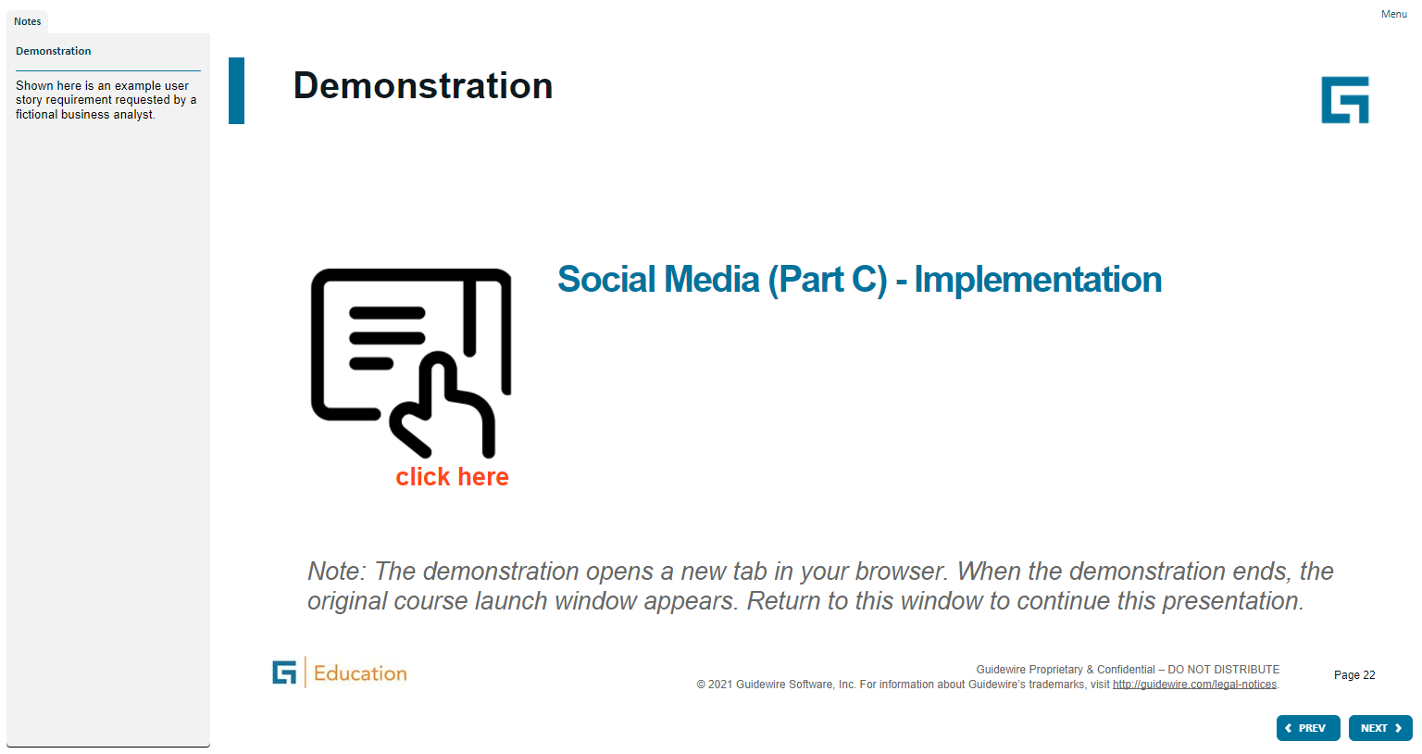
Notes:
Container widgets hold other widgets. Each one can be defined either in its own file or as a child container within some other PCF element file.
Both Widget and Location are conceptual representations in this diagram. There are no <Widget /> or <Location /> elements. Similarly, both Atomic Widget and Container Widget are conceptual representations. There are no <Atomic Widget /> or <Container Widget /> elements.
The PCF object model is container-based. Each screen element is modeled as an object, which may contain other objects. The hierarchical structure simplifies the task of locating and modifying visual elements. Furthermore, each element can be declared as an independent and therefore reusable element.

Slide 18
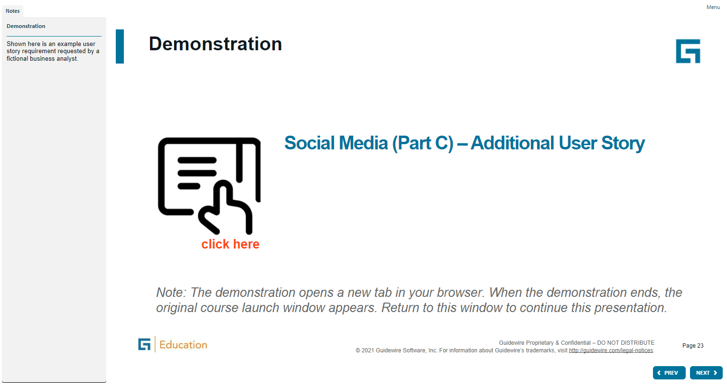
Notes:
Container widgets hold other widgets. Each one can be defined either in its own file or as a child container within some other PCF element file.
Both Widget and Location are conceptual representations in this diagram. There are no <Widget /> or <Location /> elements. Similarly, both Atomic Widget and Container Widget are conceptual representations. There are no <Atomic Widget /> or <Container Widget /> elements.
The PCF object model is container-based. Each screen element is modeled as an object, which may contain other objects. The hierarchical structure simplifies the task of locating and modifying visual elements. Furthermore, each element can be declared as an independent and therefore reusable element.

Slide 19
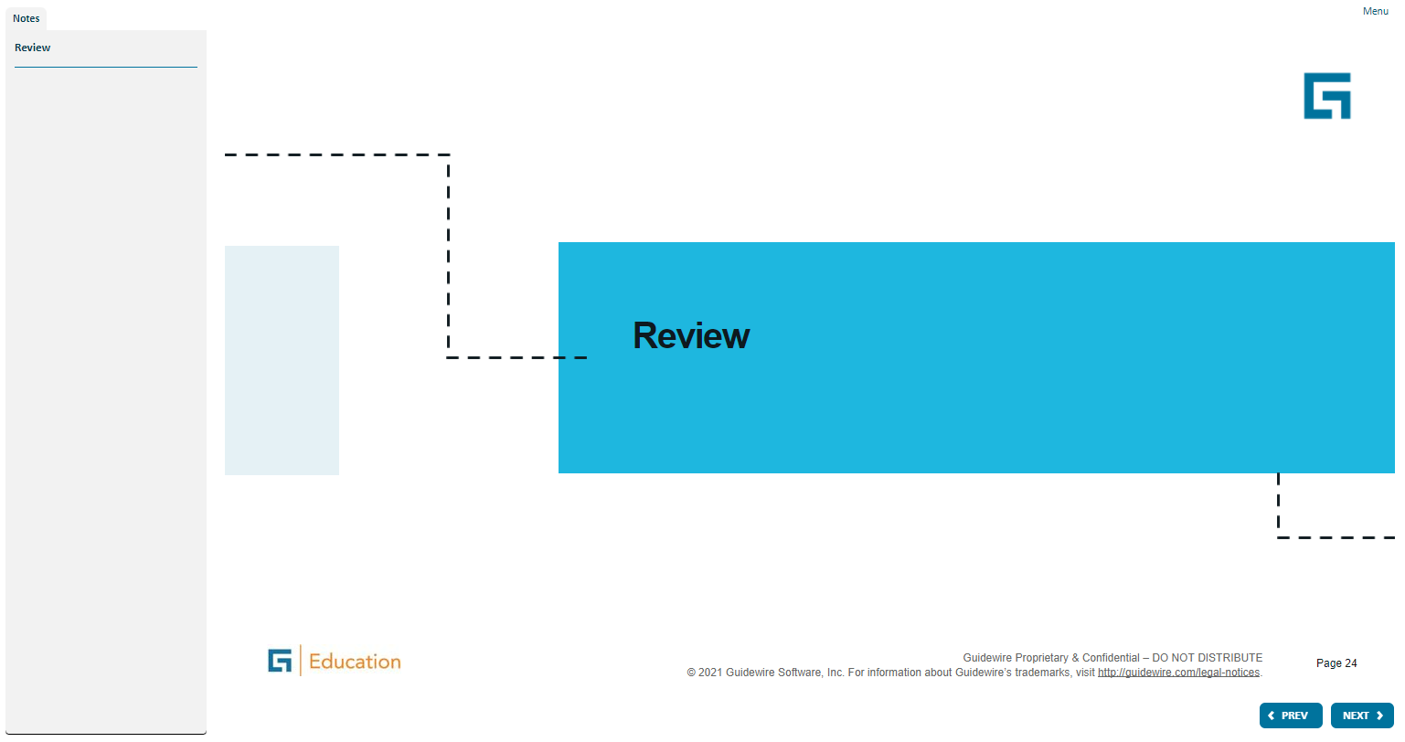
Notes:
Container widgets hold other widgets. Each one can be defined either in its own file or as a child container within some other PCF element file.
Both Widget and Location are conceptual representations in this diagram. There are no <Widget /> or <Location /> elements. Similarly, both Atomic Widget and Container Widget are conceptual representations. There are no <Atomic Widget /> or <Container Widget /> elements.
The PCF object model is container-based. Each screen element is modeled as an object, which may contain other objects. The hierarchical structure simplifies the task of locating and modifying visual elements. Furthermore, each element can be declared as an independent and therefore reusable element.

Slide 20
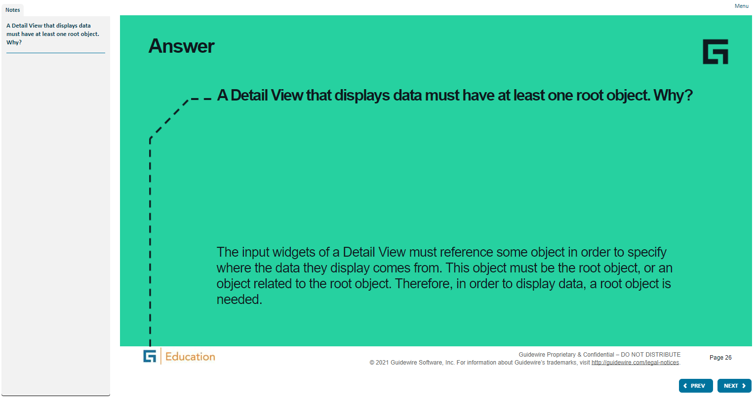
Notes:
Container widgets hold other widgets. Each one can be defined either in its own file or as a child container within some other PCF element file.
Both Widget and Location are conceptual representations in this diagram. There are no <Widget /> or <Location /> elements. Similarly, both Atomic Widget and Container Widget are conceptual representations. There are no <Atomic Widget /> or <Container Widget /> elements.
The PCF object model is container-based. Each screen element is modeled as an object, which may contain other objects. The hierarchical structure simplifies the task of locating and modifying visual elements. Furthermore, each element can be declared as an independent and therefore reusable element.

Slide 21
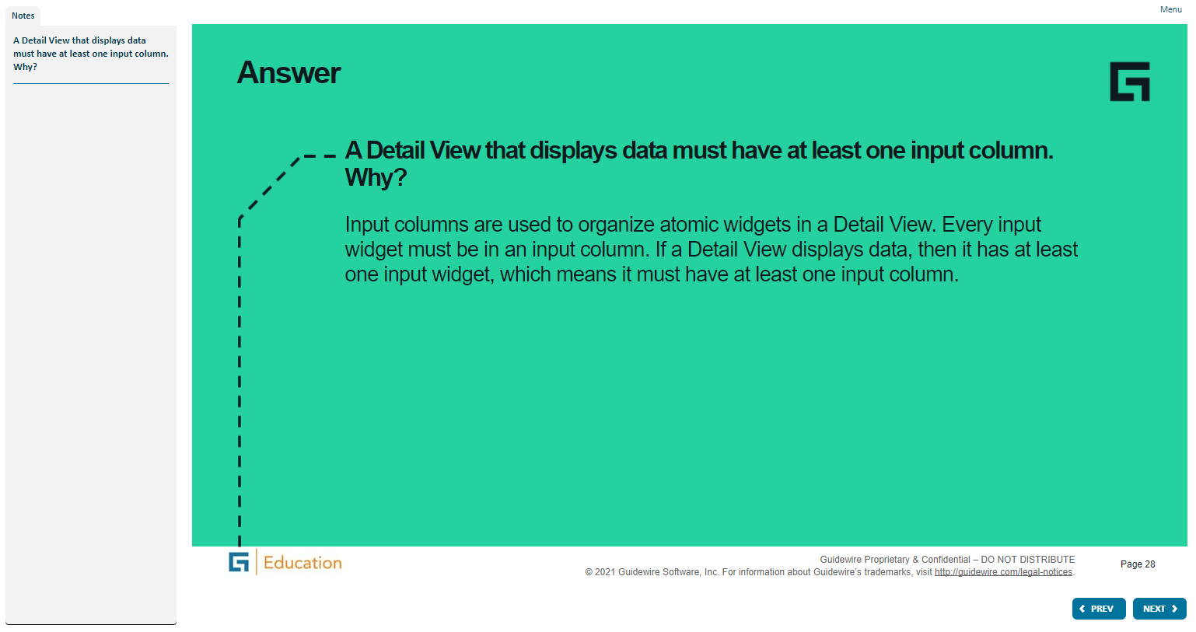
Notes:
Container widgets hold other widgets. Each one can be defined either in its own file or as a child container within some other PCF element file.
Both Widget and Location are conceptual representations in this diagram. There are no <Widget /> or <Location /> elements. Similarly, both Atomic Widget and Container Widget are conceptual representations. There are no <Atomic Widget /> or <Container Widget /> elements.
The PCF object model is container-based. Each screen element is modeled as an object, which may contain other objects. The hierarchical structure simplifies the task of locating and modifying visual elements. Furthermore, each element can be declared as an independent and therefore reusable element.

Slide 22
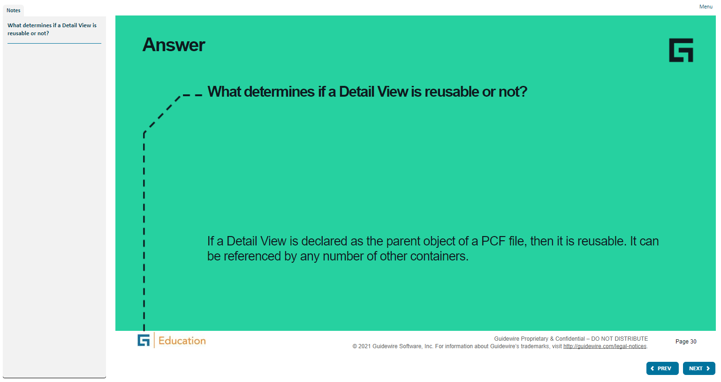
Notes:
Container widgets hold other widgets. Each one can be defined either in its own file or as a child container within some other PCF element file.
Both Widget and Location are conceptual representations in this diagram. There are no <Widget /> or <Location /> elements. Similarly, both Atomic Widget and Container Widget are conceptual representations. There are no <Atomic Widget /> or <Container Widget /> elements.
The PCF object model is container-based. Each screen element is modeled as an object, which may contain other objects. The hierarchical structure simplifies the task of locating and modifying visual elements. Furthermore, each element can be declared as an independent and therefore reusable element.

Slide 23
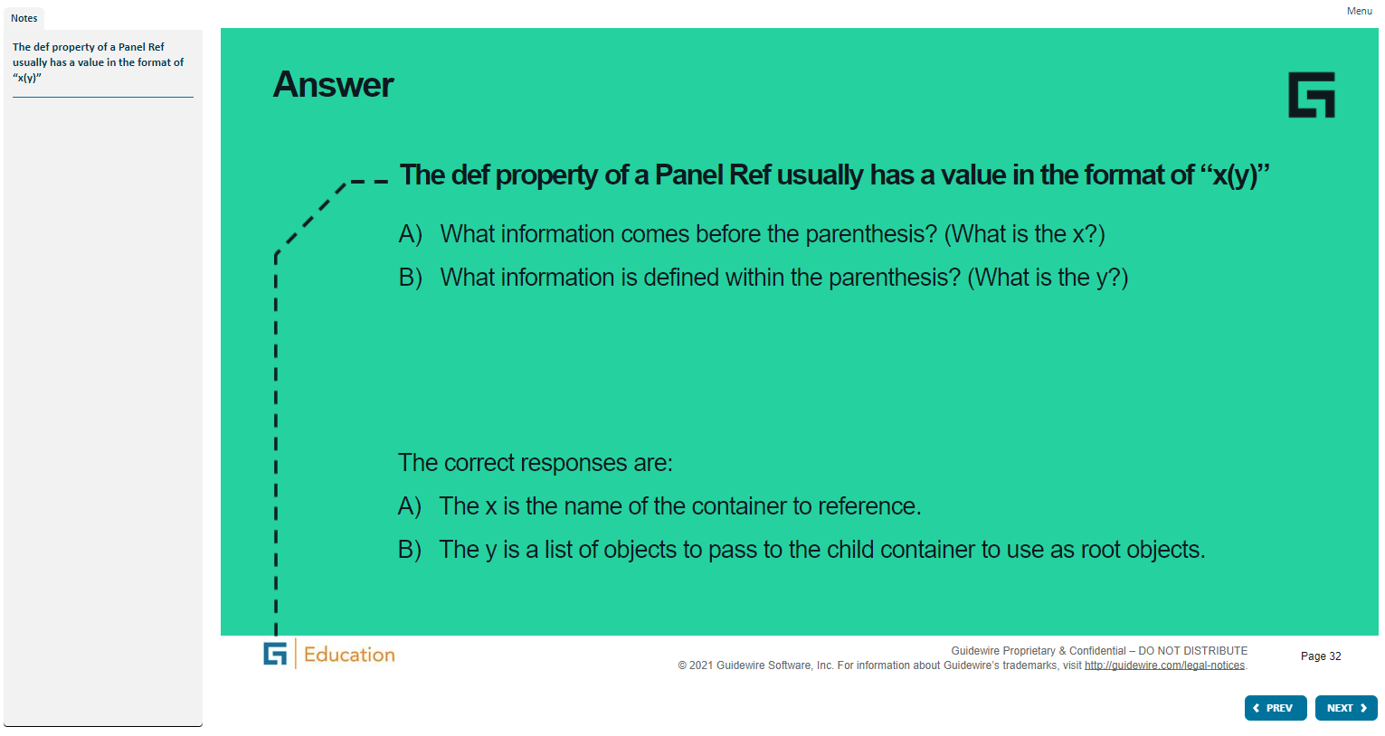
Notes:
Container widgets hold other widgets. Each one can be defined either in its own file or as a child container within some other PCF element file.
Both Widget and Location are conceptual representations in this diagram. There are no <Widget /> or <Location /> elements. Similarly, both Atomic Widget and Container Widget are conceptual representations. There are no <Atomic Widget /> or <Container Widget /> elements.
The PCF object model is container-based. Each screen element is modeled as an object, which may contain other objects. The hierarchical structure simplifies the task of locating and modifying visual elements. Furthermore, each element can be declared as an independent and therefore reusable element.

Slide 24
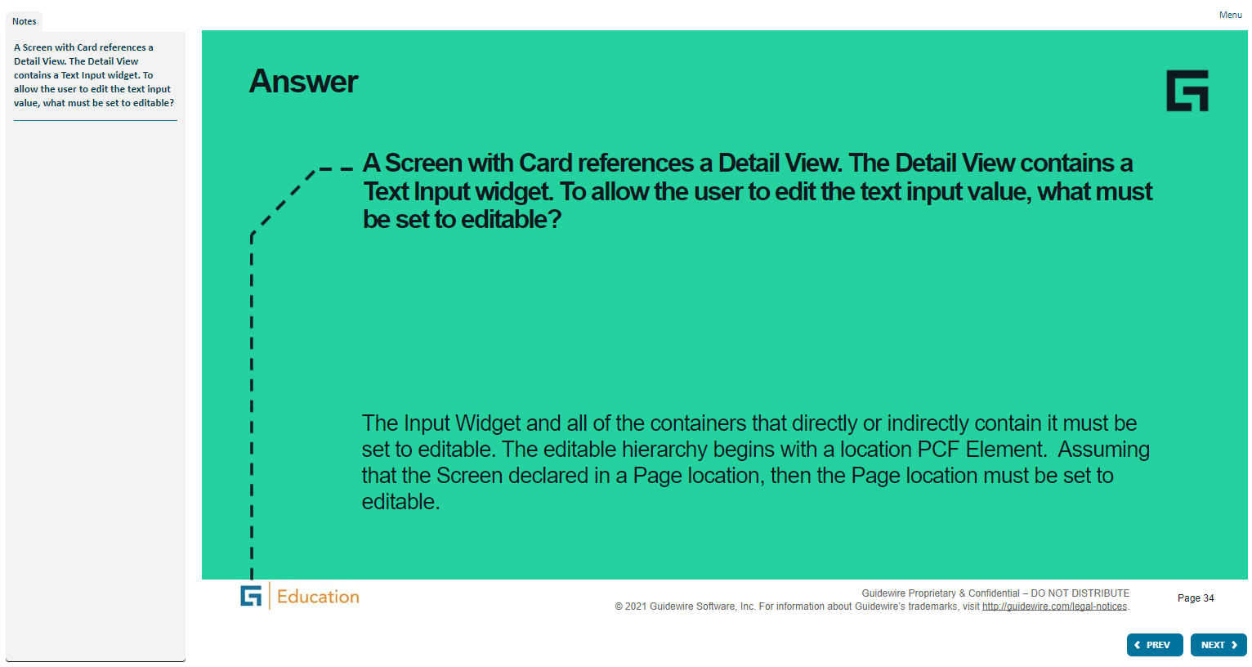
Notes:
Container widgets hold other widgets. Each one can be defined either in its own file or as a child container within some other PCF element file.
Both Widget and Location are conceptual representations in this diagram. There are no <Widget /> or <Location /> elements. Similarly, both Atomic Widget and Container Widget are conceptual representations. There are no <Atomic Widget /> or <Container Widget /> elements.
The PCF object model is container-based. Each screen element is modeled as an object, which may contain other objects. The hierarchical structure simplifies the task of locating and modifying visual elements. Furthermore, each element can be declared as an independent and therefore reusable element.

Slide 25
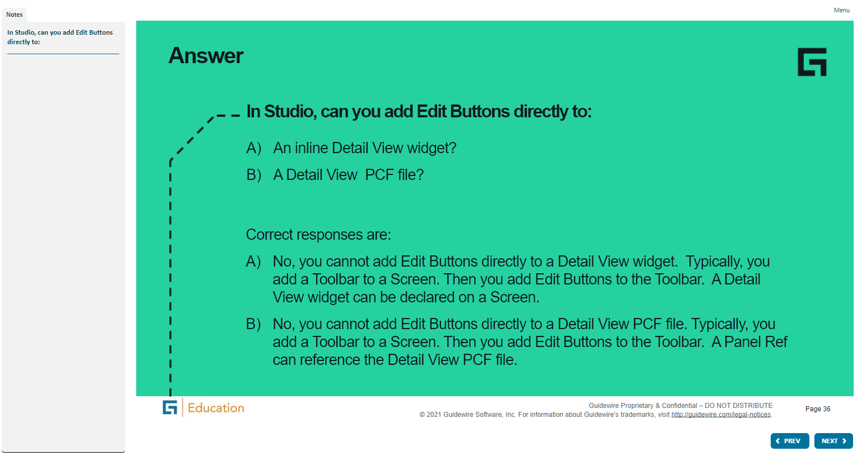
Notes:
Container widgets hold other widgets. Each one can be defined either in its own file or as a child container within some other PCF element file.
Both Widget and Location are conceptual representations in this diagram. There are no <Widget /> or <Location /> elements. Similarly, both Atomic Widget and Container Widget are conceptual representations. There are no <Atomic Widget /> or <Container Widget /> elements.
The PCF object model is container-based. Each screen element is modeled as an object, which may contain other objects. The hierarchical structure simplifies the task of locating and modifying visual elements. Furthermore, each element can be declared as an independent and therefore reusable element.

Slide 26

Notes:
Container widgets hold other widgets. Each one can be defined either in its own file or as a child container within some other PCF element file.
Both Widget and Location are conceptual representations in this diagram. There are no <Widget /> or <Location /> elements. Similarly, both Atomic Widget and Container Widget are conceptual representations. There are no <Atomic Widget /> or <Container Widget /> elements.
The PCF object model is container-based. Each screen element is modeled as an object, which may contain other objects. The hierarchical structure simplifies the task of locating and modifying visual elements. Furthermore, each element can be declared as an independent and therefore reusable element.

Slide 27
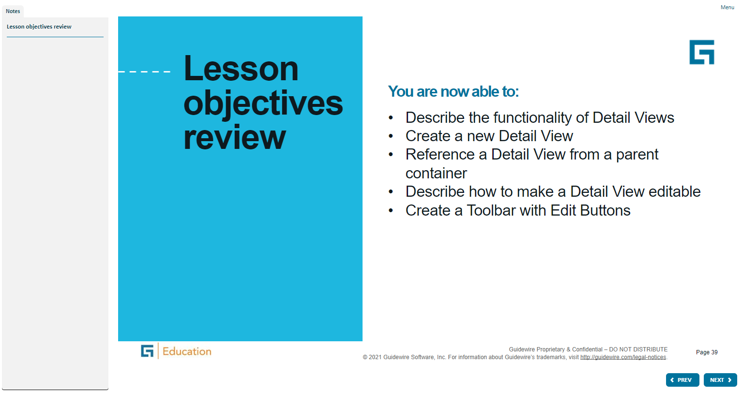
Notes:
Container widgets hold other widgets. Each one can be defined either in its own file or as a child container within some other PCF element file.
Both Widget and Location are conceptual representations in this diagram. There are no <Widget /> or <Location /> elements. Similarly, both Atomic Widget and Container Widget are conceptual representations. There are no <Atomic Widget /> or <Container Widget /> elements.
The PCF object model is container-based. Each screen element is modeled as an object, which may contain other objects. The hierarchical structure simplifies the task of locating and modifying visual elements. Furthermore, each element can be declared as an independent and therefore reusable element.

Slide 28
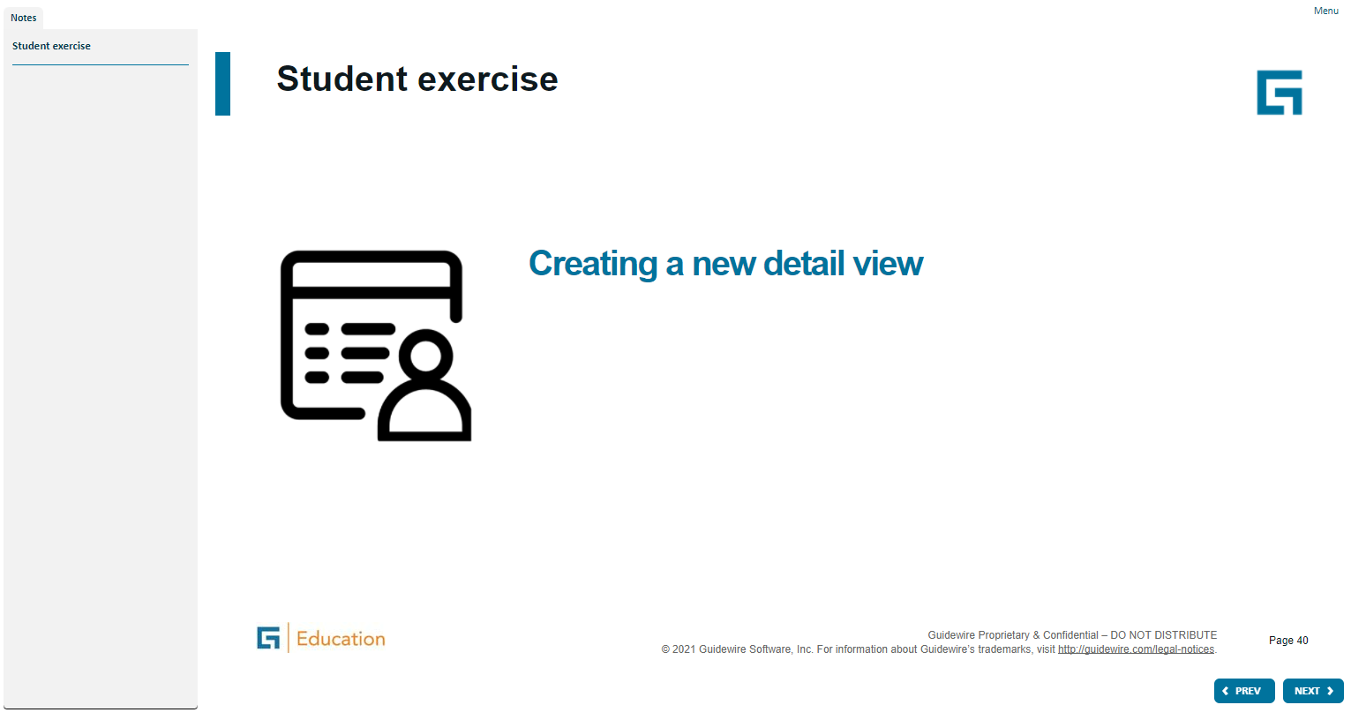
Notes:
Container widgets hold other widgets. Each one can be defined either in its own file or as a child container within some other PCF element file.
Both Widget and Location are conceptual representations in this diagram. There are no <Widget /> or <Location /> elements. Similarly, both Atomic Widget and Container Widget are conceptual representations. There are no <Atomic Widget /> or <Container Widget /> elements.
The PCF object model is container-based. Each screen element is modeled as an object, which may contain other objects. The hierarchical structure simplifies the task of locating and modifying visual elements. Furthermore, each element can be declared as an independent and therefore reusable element.

